Slide 1



Deliveroo
AdClick
Prediction
DSBA | Marketing Analytics | 2023

Slide 2
Work By
Irene SUNNY
B00798876
4.30PM - 7.30pm
Rhianne GONSALVES
B00798683
1:15PM - 4:15pm
Poongkundran Thamaraiselvan
B00798732
4.30PM - 7.30pm
Hossam M’hal
B00775092
1.15PM - 4.15pm
Roshan Velpula
B00802760
4.30PM - 7.30pm
Nishtha KHURANA
B00805298
4.30PM - 7.30pm
Yahya Janboubi
B00815356
1.15PM - 4.15pm

Slide 3
Agenda
01
Background
04
EDA and Preprocessing
07
Inference and Recommendations
02
Problem in Hand
05
Model Selection
08
Conclusion
03
Dataset Description
06
Results
09
Appendix

Slide 4
Background
01
Founded in 2013, Deliveroo is a prominent British online food delivery platform that connects customers with a diverse range of local restaurants, facilitating convenient and efficient meal ordering and delivery. Through a user-friendly mobile app, website interface and a dedicated network of drivers, Deliveroo provides users with access to a array of culinary choices delivered to their doorstep.

Slide 5
Deliveroo Overview
01
Online Food Delivery Leader
04
Efficient Delivery System
02
Extensive Restaurant Network
05
Global Operations
03
06
Tech-Driven Optimization
User-Friendly Platform
Sources
https://deliveroo.fr/fr/about-us

Slide 6
Deliveroo Key Figures
Number of Users
Revenue
7.4 million MAU*
*Monthly active users
2.0bn £
Countries
Partners
6 countries ( UK, France, EAU,Italy, Hong Kong)
176 000 partners*
*Restaurants and Grocers
Source
https://corporate.deliveroo.co.uk/investors/annual-report-summary/

Slide 7
Problem In Hand
02
"Half the money I spend on advertising is wasted; the trouble is I don't know which half." - John Wanamaker
By leveraging machine learning and strategic data analysis, we aim to pinpoint and optimize the most effective half, ensuring a more efficient allocation of resources and maximizing the impact of Deliveroo’s advertising campaigns.
We are dealing with a ‘classic’ classification problem where we are going to predict the Ad click conversion by a user, given the available information.

Slide 8
Problem In Hand
As a group of Data Scientists and Marketing Analysts, our main goal is to :
01
Understand the available data
02
Perform data analysis
03
Leverage the best ML models to make predictions
04
Offer strategic recommendations to Deliveroo’s marketing team
Predicting ad click patterns optimizes marketing spend by targeting the most relevant audience, increasing efficiency and ROI. It also refines ad content and placement, enhancing engagement and conversion with the intended demographic.

Slide 9
Dataset Overview
03
This dataset contains customer interaction with Ad campaign of Deliveroo. It has information about social media interaction, timings, demography and lot more.

Slide 10
18000
Length of the Dataset
Region: Indicates the geographical locations of the customers in France (5 regions).
Daytime: Numerical representation of the time of day.
Carrier: Customer’s mobile service provider
(4 carriers).
Time on Previous Website: Duration of customer’s engagement before click in seconds.
Weekday: Day of interaction (7 days).
Social Network: Originating social platform
(3 networks).
Number of Previous Orders: Number of previous orders by the customer.
Restaurant type: Customer’s choice of cuisine (5 cuisines)
Click Conversion: Binary indicator of conversion - 1 (clicked), 0 (not clicked)
8
Features
3
Numerical
5
Categorical

Slide 11
EDA & PreProcessing
04
This section provides a comprehensive study about the Dataset, exploring the statistics, patterns and distribution of the data.
We will also take a look at the necessary preprocessing steps done to ensure suitability, accuracy and reliability of models

Slide 12
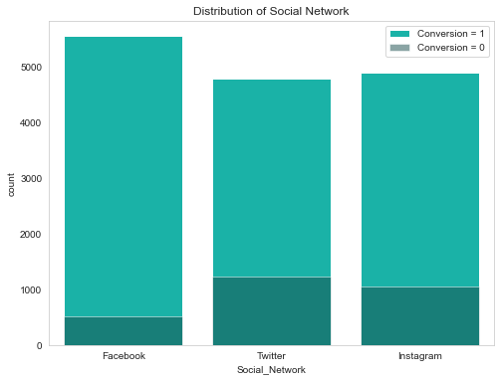
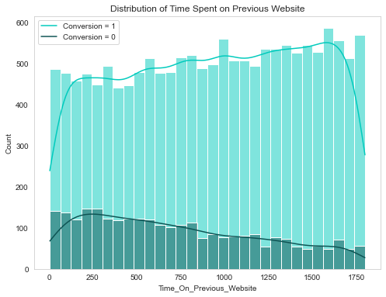
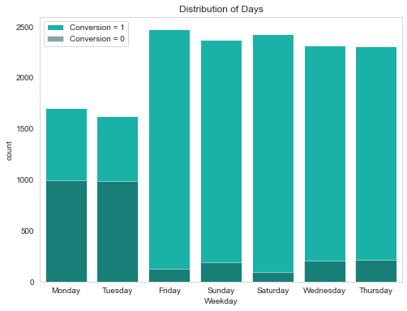
Fig 1.
Fig 3.
Fig 2.
84%
Converted
26%
More time spent on website by the converted
43%
More conversions on Wed-Sun vs Mon-Tue

Slide 13
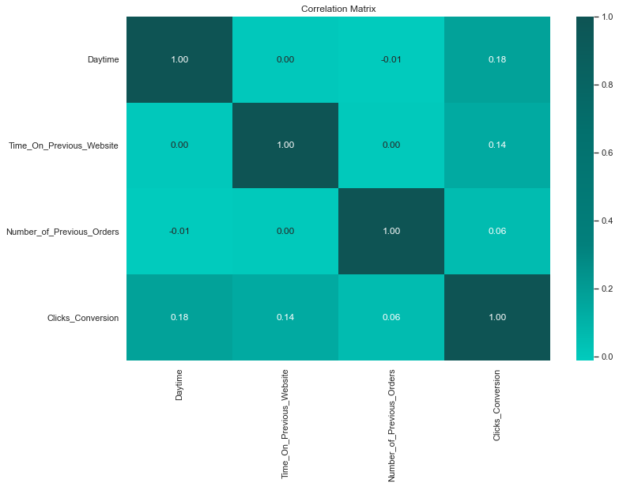
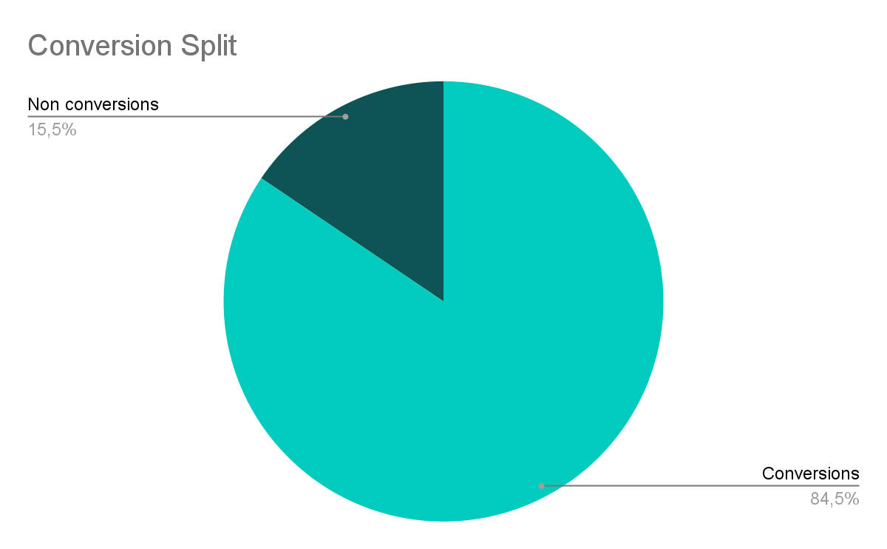
Fig 4. Features and their normalised GVIF score.
Dataset Imbalance:
From the conversion split we can infer that the dataset is imbalanced as we have fewer instances of non-conversion (15%). Refer Fig 5
Correlation:
No strong correlation in the numerical columns, indicating non-linear patterns or complex relationships amongst datapoints. Refer Fig 6
Multicollinearity:
No evidence for multicollinearity in the dataset from ViF Test. Refer Fig 5
(Refer appendix 1 for more details)
Feature | GVIF^(1/(2*Df))
Region | 1.000464
Daytime | 1.000591
Carrier | 1.000576
Time_On_Previous_Website | 1.000868
Weekday | 1.000344
Social_Network | 1.000522
Number_of_Previous_Orders | 1.048097
Restaurant_Type | 1.012109
Fig 6.
Fig 5. Split of Conversions and Non-Conversion

Slide 14
Preprocessing
Data is fairly clean to begin with. Some cleaning and preprocessing conducted to make it compatible with the models to be tested.
Missing Values:
Method: We found 1848 missing values in ‘restaurant type’ and imputed them using Mode.
Reason: For categorical variables, applying mode helps in retaining the original distribution. Easy to interpret.
Standardisation:
Method: For numeric values with no outliers, Z -Standardization was applied as the method is sensitive to outliers (Refer Appendix 2)
Reason: Z -standardization squishes the input features to be between -1 to 1.
Scaling:
Method: For all the numeric values with outliers, Robust Scaler applied (Refer Appendix 3). ‘Daytime’ was already robust scaled.
Reason: Robust scaling takes median of the values which is robust to the outliers
Encoding:
Method: For all the categorical variables, we applied one-hot encoding to convert them into numerical representation
Reason: For many ML models, the input data has to be in numerical form to perform better
28 numerical features to train our models, post pre-processing

Slide 15
05
Modelling
In this section we will discuss about the ML models we tested, we will deep dive into the nuances of our best performing models

Slide 16
First Steps
Models were chosen based on their suitability for classification tasks, aiming to deliver optimal performance and insightful predictions.
Tree Based Models
Why ? EDA revealed non-linear relationship of data.
Tree-based models do not assume any linear relationship between the independent and dependent variables. They also inherently offer insights into feature importance.
Models we tested
Decision Trees
Random Forest
XGB
Also tested fundamental models like Logistic Regression and KNN.
For tree based models, feature selection was done and we tuned the hyperparameters to find the best result for the metric of our choice and also to address the existing class imbalance problem.

Slide 17
Criteria and Model Selection
Metrics
Since this is a binary classification problem, we should focus on classification metrics like Precision, Recall, F1 Score and AUC
In the business context of deliveroo, we want to capture as many conversions as possible because it’s costly to miss out on a potential customer. This implies minimising false negatives. Here we assume that ads are not PPC else we might want to minimise false negatives, as well.
So, ‘Recall’ was prioritised over others while trying not to compromise on ‘Accuracy’
Fig 7. Initial results of all models tested with default parameters and all features
Model | Accuracy | Recall | F1 Score | AUC
Decision Tree | 0.9069 | 0.5385 | 0.6521 | 0.7970
Random Forest | 0.9422 | 0.7834 | 0.8007 | 0.9816
XG Boost | 0.9456 | 0.7822 | 0.8231 | 0.9844
Logistics Regression | 0.9347 | 0.7238 | 0.7822 | 0.9741
KNN | 0.9058 | 0.5831 | 0.6660 | 0.7753
XGB and RF were picked as the best performers to further fine tune and improve Accuracy and Recall.
Refer Appendix 4.1 to 4.3 for detailed results of all models tested

Slide 18
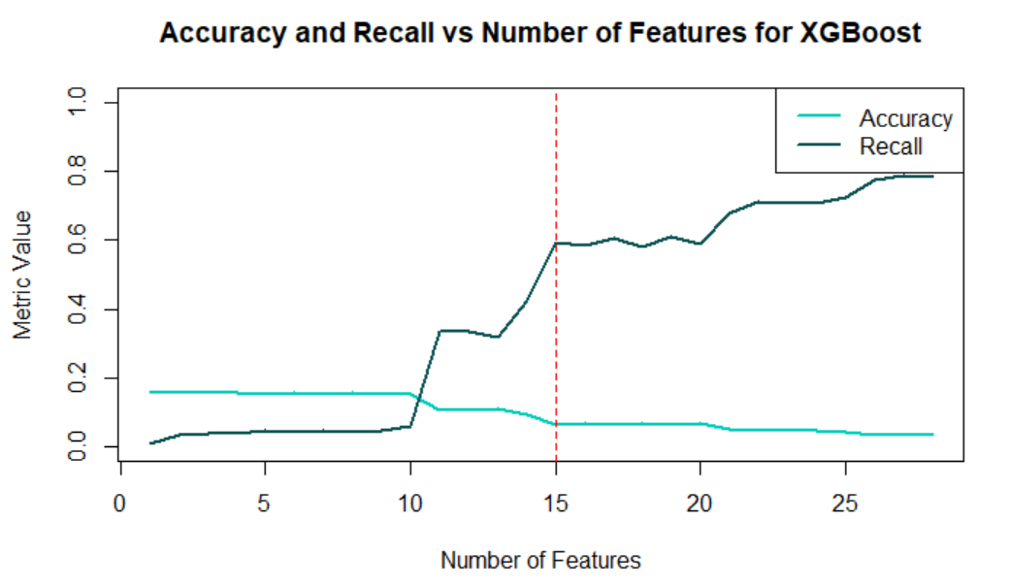
XGBoost - Extreme Gradient Boosting
XGBoost is an efficient and scalable implementation of gradient boosting machines
At its core, XGBoost uses decision trees as base learners and builds them in a sequential manner, where each new tree corrects the errors made by the previous ones.
XGB when run with default parameters assigns weights to the features based on their importance and uses all features.
However, to avoid overfitting and to improve the interpretability, we turned to manual feature selection through XGB. Identified the top 15 features that had much higher importance than the rest and helped balance Accuracy between Recall (Refer Fig 8).
Refer Appendix 5 for details
With selected features, hyper parameter tuning using Grid Search was conducted. (Refer Appendix 6.1 for details)
Fig 8.
With Hyperparameter tuning, Accuracy improved from
94% → 95%

Slide 19
Random Forest - Ensemble Decision Trees
Random Forest operates by constructing a multitude of decision trees during training and outputting the class that is the mode of the classes for classification
Hyperparameter tuning is performed using grid search approach. We observed that selecting n trees to be 200 gave a significant boost in our recall value.
(Refer Appendix 6.2 for details)
Random Forest performed better with all feature over 15 top features as the algorithm is quite robust to irrelevant features. Each time a split in a tree is considered, only a subset of features is used, allowing the algorithm to ignore irrelevant or less important features naturally.
With Hyperparameter tuning, Recall improved from
74% → 79%

Slide 20
Ensemble XGB and RF - The Best Model
Then we decided to create an ensemble of Random Forest and XGBoost which involved combining the predictions from both models to make a final prediction and thereby get the best of Accuracy and Recall.
It averages the binary predictions from the XGBoost and Random Forest models. This step effectively means that if both models agree on the classification, the ensemble will also agree.
 | XGB | RF
Accuracy | 95.17% | 94.56%
Recall | 78% | 79%
With Ensemble, a significant improvement in Recall is observed
79% → 82.85%
While not compromising on Accuracy
95% → 94%

Slide 21
05
Results
In this section we will present the results of our model and our accuracy in addressing the problem in hand. From this result, we will be able to formulate recommendations to Deliveroo’s decision makers.

Slide 22
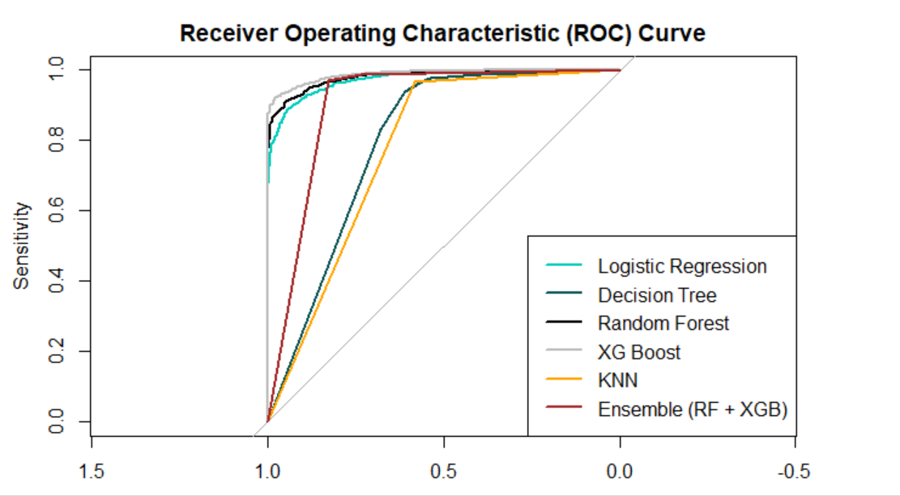
Metrics Summary
Fig 9.
 | Accuracy | F1 Score | Recall
XGB | 95% | 83.1% | 77%
RF | 94.4% | 82.1% | 79%
Ensemble | 94.6% | 83.4% | 82.8%
Refer Appendix 7.1 to 7.3 for the complete results
For Deliveroo, the choice between minimizing false positives (favoring precision) or false negatives (prioritizing recall) impacts ad costs and brand image. XGB offers higher accuracy at 95.1%, while Ensembling it with Random Forest focuses on improving Recall in order to not miss out on potential clicks.
We believe Deliveroo should focus on minimizing false negatives, as the cost of missing a potential click and subsequent conversion is deemed higher than targeting users who may not click, thus emphasizing the importance of Recall (Sensitivity) delivered by XGBoost & Random Forest.
The ensemble model, although not towards the extreme left strikes a balance between sensitivity and specificity at a threshold that optimizes both recall and accuracy.
Refer Appendix 8 for the complete results

Slide 23
Prediction dashboard
Final Predictions on Prediction Dataset
Behaviour | XGB | Ensemble
0 - no click | 252 | 235
1 - click | 1748 | 1765
Total | 2000 | 2000
2000 observations were provided to make predictions. Above is the results from both XGB and Ensemble. They will be available to explore on dashboard and also submitted as CSV file for validation.

Slide 24
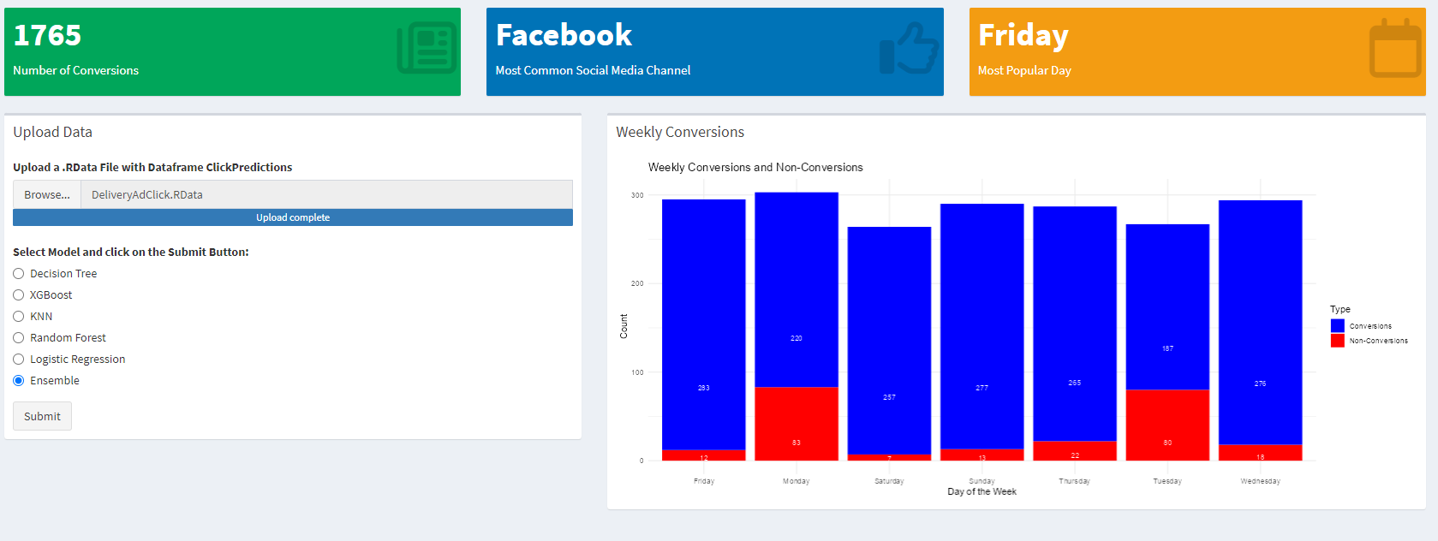
Prediction dashboard
Weekly Performance Summary
This dashboard highlights
Weekly conversion analysis, specifying that it pertains to Deliveroo's various acquisition channels.
Key Metrics - (Total conversions in the dataset, Top performing conversion channel, Day with the highest number of conversions )
Top performing conversion channel Facebook (in this scenario)
Day with highest conversions
Friday (in this scenario)

Slide 25
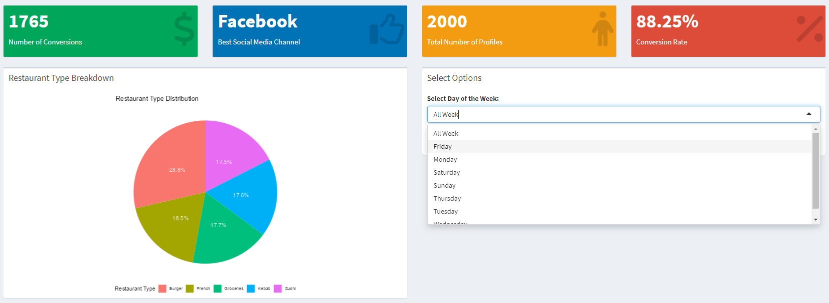
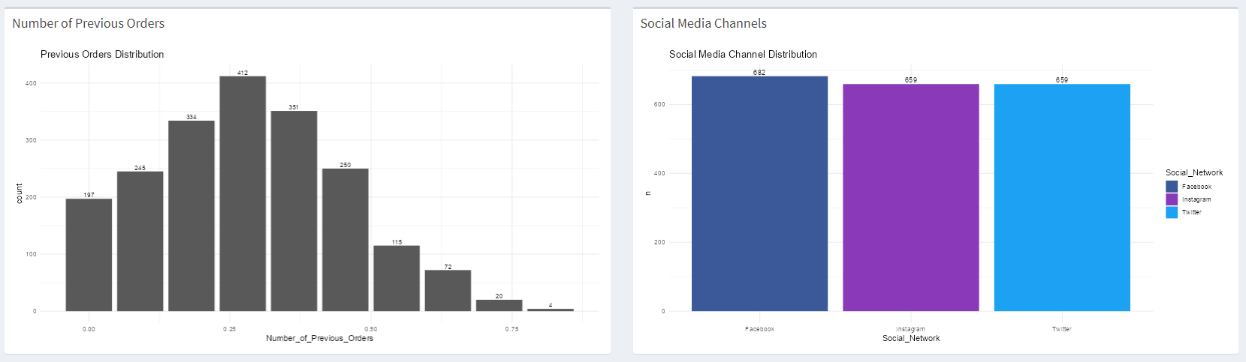
Prediction dashboard
These plots summarize the KPI’s for weekday
Brand Loyalty
Best performing Social media
We noticed that there is a major trend between each day. Indeed, Facebook appears to be the best social media acquisition channel
This shows us the customer loyalty based on their previous orders
On the whole week, it’s Facebook that generates more clicks

Slide 26
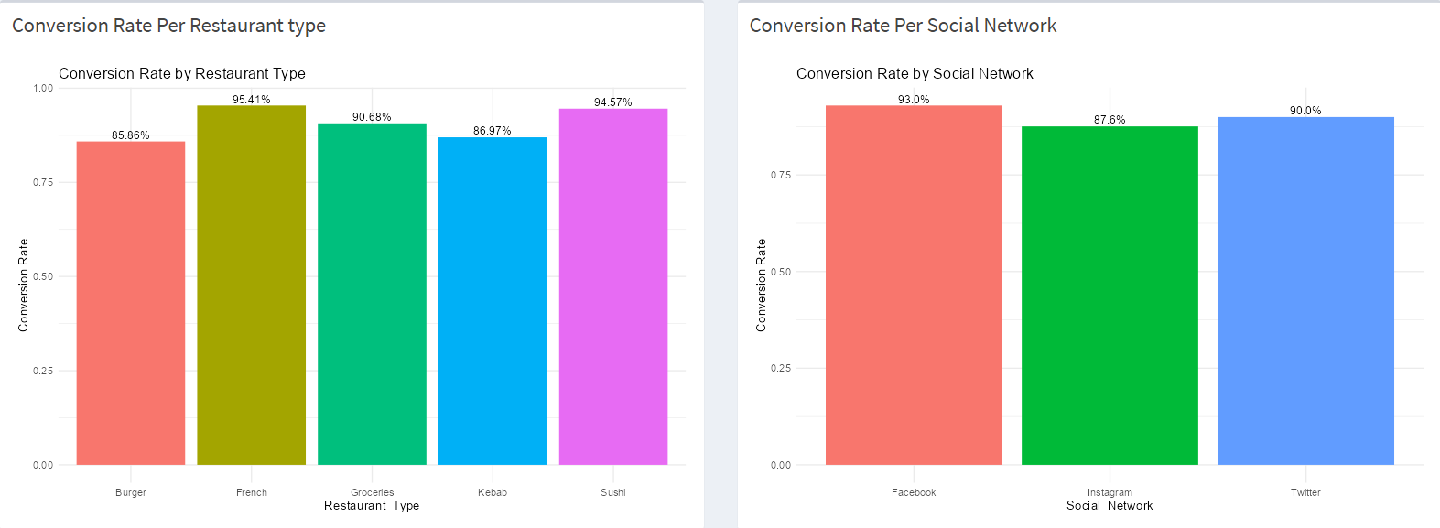
Prediction dashboard
The conversion rate for each restaurant type
The conversion rate based on the Ads on the social network

Slide 27
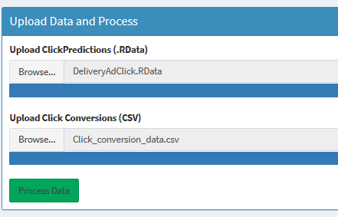
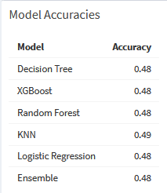
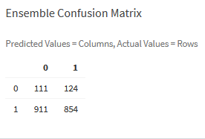
Prediction dashboard - Model evaluation
Users can upload real conversion data to see how accurate each model is and view their confusion matrices.

Slide 28
06
Implications & Recommendations
In this section we will present the recommendations to Deliveroo’s marketing department based on the modeling and the dashboards created to answer the problem in hand

Slide 29
Implications and Recommendations
01
Allocate more budget on Fridays to increase the revenue from the Ads as our dashboard revealed that Friday sees the most clicks.
02
Consider Facebook as the most performing Social Media Chanel and leverage it to increase revenues
Enhance data collection efforts by focusing on crucial demographic, weather and seasons information to be able to be more efficient in aiming for the persons that will have the most chances to convert
03

Slide 30
Implications and Recommendations
04
Increase the visibility of French gastronomy or sushi restaurants to boost conversion rates
Client Loyalty should be considered for retargeting : They are more likely to convert if they have already placed orders with Deliveroo. Also the ones who clicked on the ads but did not get converted to sales should be retargeted
05
06
Based on the advertising budget, utilize PPC (Pay-Per-Click) targeting for potential clickers to enhance order conversion optimization
07
Identify and focus on regions with high engagement or potential for conversion, investing more in offline and retail marketing efforts in these areas.

Slide 31
Conclusion
07
Throughout our work for Deliveroo, we had had the opportunity to explore several leads to process the available data efficiently,select the best predictive model and deliver the most insightful recommendations. In this section we will encapsulate the key findings and insights derived from our model, emphasizing their significance in addressing Deliveroo's challenges

Slide 32
Conclusion
i
Redefining objective : Apart from accuracy, not missing potential interested customers (recall) was also considered top priority
ii
Feature Engineering Approach: Employing robust scaling and XG-Boost for feature prioritization proved crucial for model precision and managing data anomalies effectively
iii
Best model : Found Ensemble model blending XGBoost and Random forest achieved our intended objective
iv
Advanced modeling Techniques:More sophisticated algorithms like neural networks can be employed to capture complex patterns in the future
v
Real-Time Data Incorporation: Integrate real-time user interaction data to dynamically adjust predictions and improve accuracy

Slide 33
08
Appendix
In the appendix section, we will include supplementary materials and detailed information that support our analysis and conclusions.

Slide 34
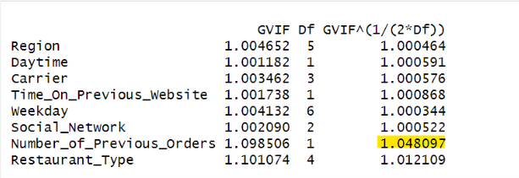
1.Variance Inflation Factor (VIF)
GVIF^(1/(2*Df)) values ~ 1
( suggesting minimal multicollinearity)
'Number_of_Previous_Orders' stands out with a marginally higher value, but it is
still well within acceptable ranges
GVIF
Generalization of the VIF for use with categorical variables that have more than two levels
To make GVIF comparable to VIF ⇒ we consider GVIF^(1/(2Df)) where Df=number of levels-1 (categorical variable) otherwise 1 (continuous variable)
Helps in normalization when Df increases → GVIF increases

Slide 35
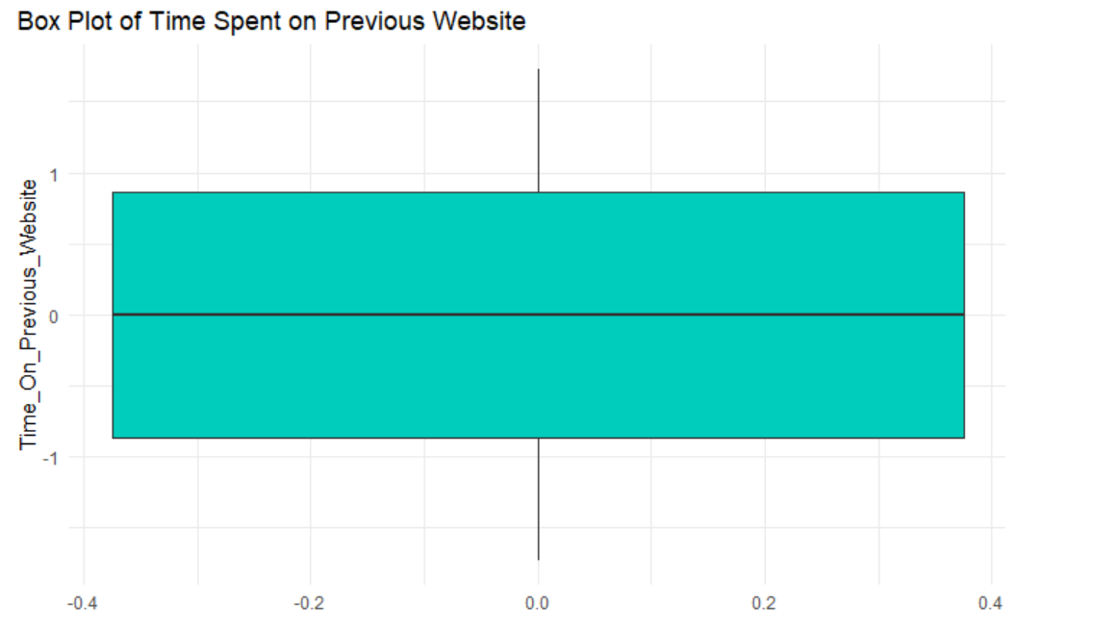
2. Box Plot - Time Spent On Previous Website
No outliers, hence, Z standardisation applied.

Slide 36
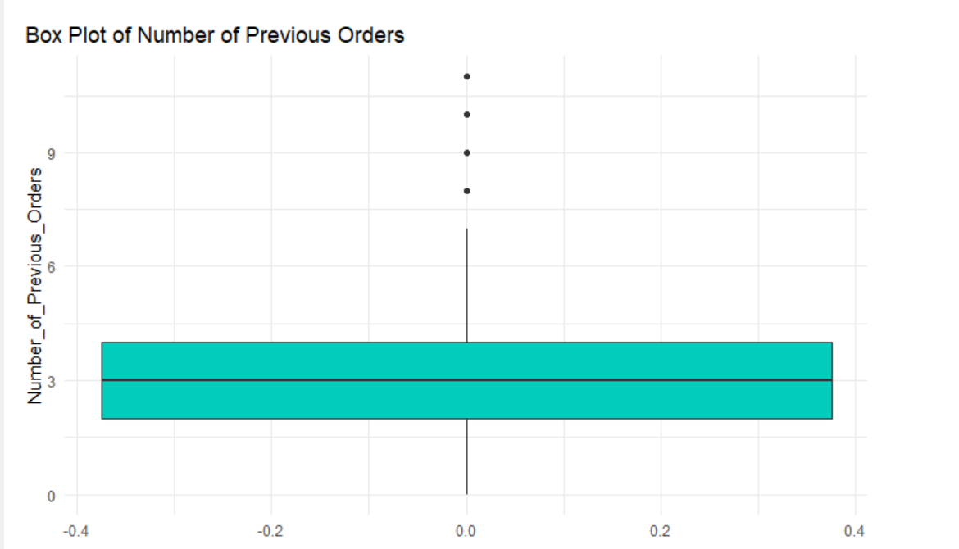
3. Box Plot - Time Spent On Previous Website
Outliers exist, hence, Robust Scale applied.

Slide 37
4.1 Confusion Matrix Essentials
 | Predicted-0 | Predicted-1
Actual-0 | TN | FP
Actual-1 | FN | TP
Focus:
Enhancing Recall to capture potential customers without compromising on Accuracy in identifying click behaviors
Recall=TP/(TP+FN)
Precision=TP/(TP+FP)
Accuracy=TP+TN/(TP+TN+FP+FN)
F1-score=2×(Precision×Recall​)/(Precision+Recall)

Slide 38
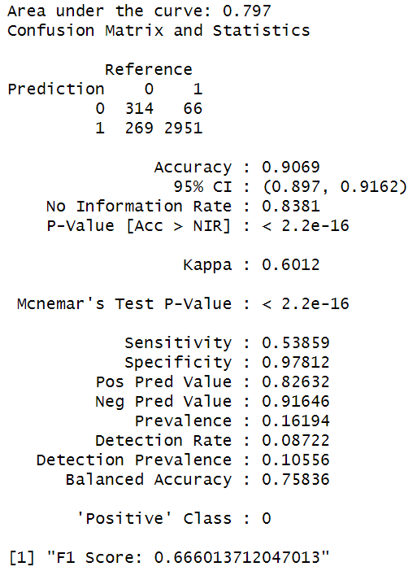
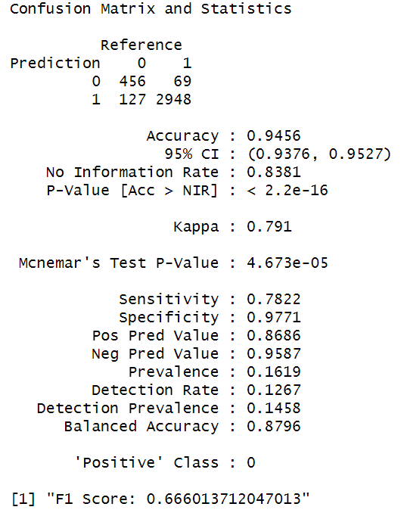
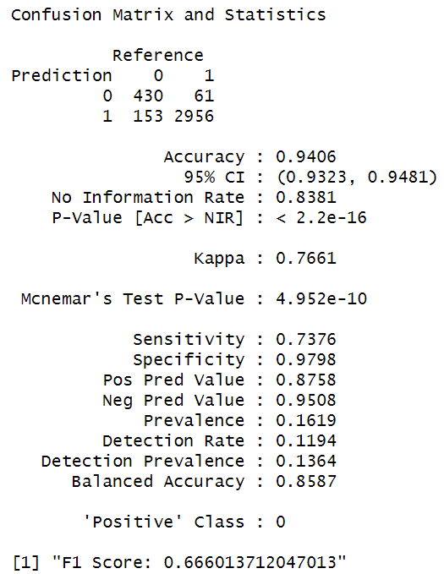
4.2 Result : All Tested Models at Initial Stage - 1/2
Decision Tree
XGBoost
Random forest

Slide 39
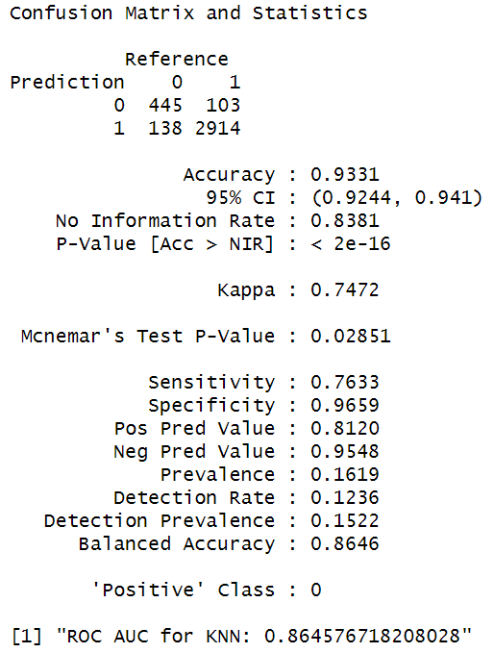
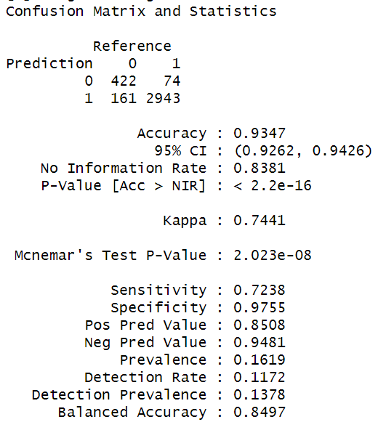
4.3 Result : All Tested Models at Initial Stage - 2/2
KNN
Logistics Regression

Slide 40
5. Top 15 Important Features via XGB
Feature | Gain | Cover | Frequency
Carrier_Free | 0.197268629 | 0.103837760 | 0.030237581
Daytime | 0.159735113 | 0.204016075 | 0.261579074
Time_On_Previous_Website | 0.120451340 | 0.162505487 | 0.251499880
Weekday_Tuesday | 0.108175428 | 0.076545099 | 0.024718023
Weekday_Monday | 0.104132303 | 0.074509562 | 0.028077754
Social_Network_Facebook | 0.062755228 | 0.041869803 | 0.029757619
Number_of_Previous_Orders | 0.060749963 | 0.056155771 | 0.095992321
Restaurant_Type_Groceries | 0.042438102 | 0.045785377 | 0.026877850
Restaurant_Type_Sushi | 0.021482275 | 0.029445056 | 0.018238541
Restaurant_Type_French | 0.016950575 | 0.032230978 | 0.016558675
XGBoost calculates feature importance during the training process using methods like Gain, Coverage, and Frequency. This importance score reflects how much each feature contributes to improving the model's performance.
#Gain: The improvement in accuracy brought by a feature to the branches it is on. This is the basis for selection.
#Cover: The number of times a feature is used to split the data across all trees.
#Frequency: The number of times a feature is split on.
Social_Network_Instagram | 0.015981712 | 0.007014495 | 0.020398368
Weekday_Saturday | 0.012380040 | 0.022614638 | 0.010559155
Social_Network_Twitter | 0.009455944 | 0.018092582 | 0.018478522
Weekday_Friday | 0.007815715 | 0.019086568 | 0.008159347
Carrier_Bouygues | 0.006756816 | 0.007894242 | 0.011039117

Slide 41
6.1 Hyper Parameter Tuning via Grid Search CV: XGB Tuning - 15 Features
Grid Search Cross-Validation is a systematic approach used for hyperparameter tuning involves searching exhaustively through a specified subset of hyperparameters and evaluating model performance for each combination.
Search conducted over
nrounds = c(50, 100, 150),
max_depth = c(3, 6, 9),
eta = c(0.01, 0.1, 0.3),
gamma = 0,
colsample_bytree = c(0.8, 1),
min_child_weight = c(1, 5, 10),
subsample = c(0.8, 1)
Best hyper parameters identified are
nrounds - 50
max_depth - 9
eta - 0.1
gamma - 0
colsample_bytree - 1
min_child_weight - 10
subsample 0.8
Here we took care of both overfitting prevention and class imbalance treatment. We use parameter called early_stopping_rounds which was set to 10, which means that the training will stop if the evaluation metric (log loss) does not improve for 10 consecutive rounds on the test set.
Class imbalance is addressed by calculating class weights based on the training set. The class_weights variable represents the proportion of each class in the training set, and scale_pos_weight is calculated as the inverse of the proportion of the positive class. This weight is then used in the scale_pos_weight parameter during training to give more importance to the minority class.

Slide 42
6.2 Hyper Parameter Tuning via Grid Search CV:
RF Tuning - All Features
Grid Search Cross-Validation is a systematic approach used for hyperparameter tuning involves searching exhaustively through a specified subset of hyperparameters and evaluating model performance for each combination.
Search conducted over
mtry = c(2, 5, 10),
ntree = c(100, 200, 300)
Best hyper parameters identified are
mtry: 10
ntree: 200

Slide 43
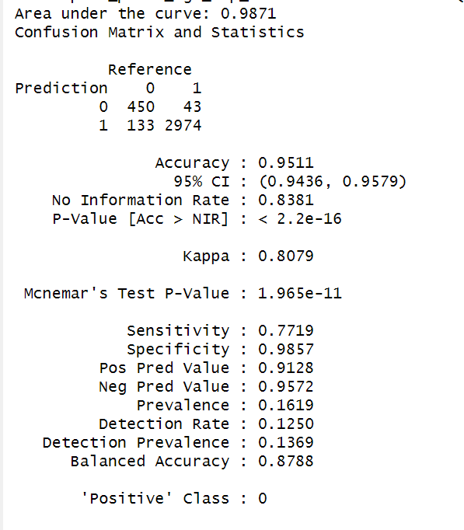
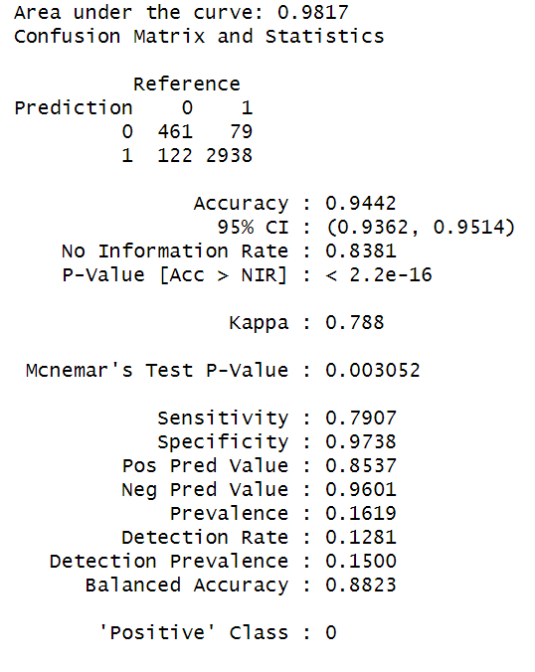
7.1 Results - XGBoost and Random Forest Tuned
XGBoost:
Random Forest

Slide 44
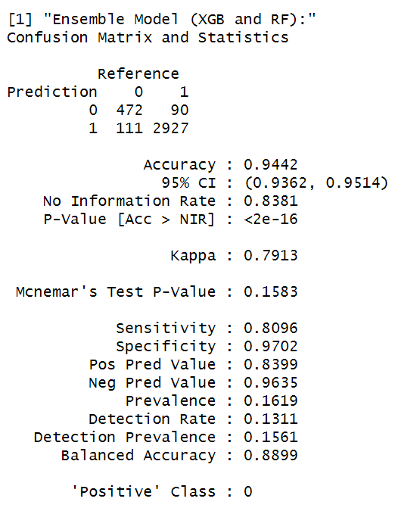
7.2 Results - Ensemble (Tuned XGB+RF)

Slide 45
8. ROC Curve - All Final Models
XGboost is the best model
(based only on ROC)
XGBoost excels in ROC performance with enhanced class separation and accuracy.
However, our chosen Ensemble approach, blending Random Forest and XGBoost, provides an optimal balance of recall, precision, and overall accuracy.
Thus,
Reducing the chances of targeting uninterested users (minimizing false positives)
Not missing potential interested customers (minimizing false negatives)

